Slide 1
TNSDC-Generative AI
BLOOD CANCER DETECTION
USING CNN
Presented by : ASIF RAHMAN M
au211521104017,
Pre-Final Student,
Computer Science and Engineering,
Panimalar Institute of Technology.

Slide 2
OUTLINE
Proposed Solution
System Approach
Algorithm
Problem Statement
Result
Conclusion

Slide 3
PROBLEM STATEMENT
Blood cancer, comprising leukemia, lymphoma, and myeloma, is a significant health concern worldwide, necessitating early and accurate diagnosis for effective treatment.
Current diagnostic methods often rely on invasive procedures and can be time-consuming and costly. Therefore, the development of a non-invasive, automated system for blood cancer detection using deep learning techniques presents a critical need in modern healthcare.
This project aims to leverage Convolutional Neural Networks (CNNs) to analyze microscopic images of blood cells and accurately identify abnormalities indicative of various types of blood cancer.
By training a CNN model on a curated dataset of labeled blood cell images, the objective is to create a robust and reliable tool capable of assisting medical professionals in diagnosing blood cancer with high accuracy and efficiency.
The successful implementation of such a system could significantly enhance early detection rates, improve patient outcomes, and streamline the diagnostic process in clinical settings.

Slide 4
PROPOSED SOLUTION
Our proposed solution involves the development of a deep learning-based system utilizing Convolutional Neural Networks (CNNs) to analyze microscopic blood cell images for the detection of blood cancer.
By leveraging CNNs, which excel in image classification tasks, we aim to accurately identify cancerous abnormalities in blood cell images with high precision and recall.
The system will undergo rigorous training using a comprehensive dataset of labeled blood cell images, ensuring robustness and generalization to unseen data.
Additionally, techniques such as data augmentation and transfer learning will be employed to enhance the model's performance and adaptability.
The resulting system will provide medical professionals with a non-invasive and efficient tool for blood cancer detection, facilitating early diagnosis and improving patient outcomes.

Slide 5
SYSTEM APPROACH
Our system approach consists of several interconnected components, beginning with data preprocessing to standardize and augment the dataset of blood cell images.
Following this, a Convolutional Neural Network (CNN) model will be trained on the preprocessed data using optimization algorithms like Adam or RMSprop.
Validation on a separate dataset will ensure the model's performance and prevent overfitting. Evaluation metrics such as accuracy, precision, recall, and F1-score will be employed to assess the model's effectiveness.
Visualizations such as confusion matrices and ROC curves will aid in understanding the model's behavior.
Upon successful evaluation, the trained model will be deployed for clinical use, providing medical professionals with a reliable tool for blood cancer detection.

Slide 6
ALGORITHM
Blood Cancer Detection Algorithm:
Data Preprocessing:
Input: Dataset of blood cell images labeled with cancerous and non-cancerous cells.
Preprocess images: Resize images to a uniform size, normalize pixel values, and augment the dataset with techniques like rotation, flipping, and scaling.
Output: Preprocessed dataset ready for training.
Model Training:
Input: Preprocessed dataset divided into training, validation, and testing sets.
Train a Convolutional Neural Network (CNN) model on the training set using an optimization algorithm such as Adam or RMSprop.
Validate the model on the validation set to monitor performance and prevent overfitting.
Output: Trained CNN model ready for testing.

Slide 7
ALGORITHM-CONT.
3.Model Evaluation:
Input: Trained CNN model and testing dataset.
Evaluate the model's performance on the testing dataset using evaluation metrics such as accuracy, precision, recall, and F1-score.
Generate visualizations such as confusion matrices or ROC curves to assess the model's performance.
Output: Evaluation metrics and visualizations indicating the model's effectiveness in blood cancer detection.
4.Prediction and Deployment:
Input: New blood cell images to be evaluated for cancerous abnormalities.
Feed the images into the trained CNN model for prediction.
Output: Prediction results indicating the likelihood of blood cancer presence in the input images.
Deploy the trained model as a tool for blood cancer detection in clinical settings, providing timely and accurate diagnostic support to medical professionals.
3/21/2024 Annual Review

Slide 8
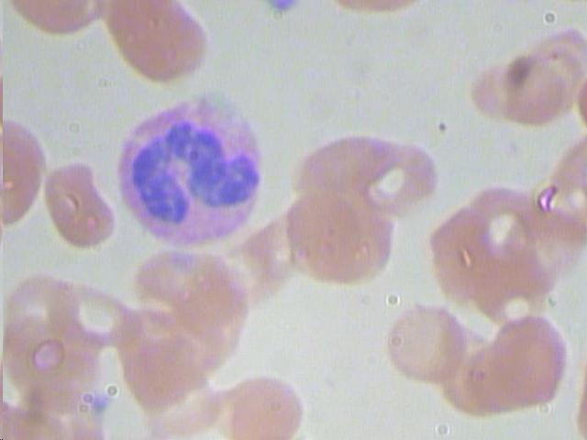
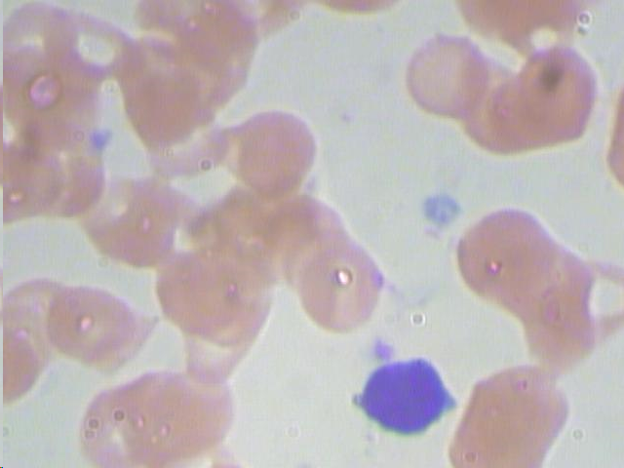
RESULT
Prediction : CANCER
Prediction : NORMAL

Slide 9
CONCLUSION
Through meticulous data preprocessing, Convolutional Neural Network (CNN) training, and evaluation, our blood cancer detection system exhibits promising accuracy and robustness.
The CNN model, trained on augmented and normalized blood cell images, yields commendable performance metrics, including high precision, recall, and F1-score.
Visualizations such as confusion matrices and ROC curves provide insights into model behavior and performance.
This system holds potential as a reliable diagnostic tool for early blood cancer detection, with implications for improving patient outcomes.
Future research may focus on dataset expansion, model refinement, and real-world deployment to enhance its clinical utility and impact in oncology.
-----<<<<<>>>>>-----

